Slide 1
Analysis of protein stretching experiments
Optical Tweezers Summer School
Santiago, Chile
11.-15. December 2024
Are Mjaavatten

Slide 2
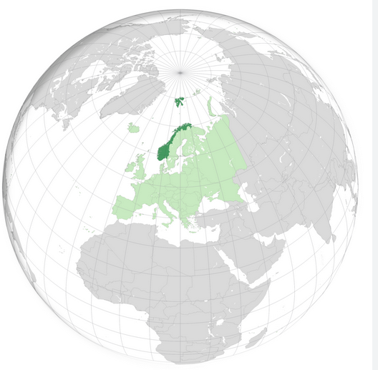
My background
Country: Norway
MSc in physics
PhD in automatic control
Worked in the petroleum and chemical processing industries
Mathematical modelling
Thermodynamics
Part-time professor at what is now The University of South-Eastern Norway

Slide 3
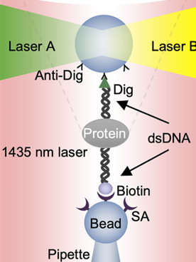
Protein pulling
Trap movement is exaggerated compared to DNA length

Slide 4
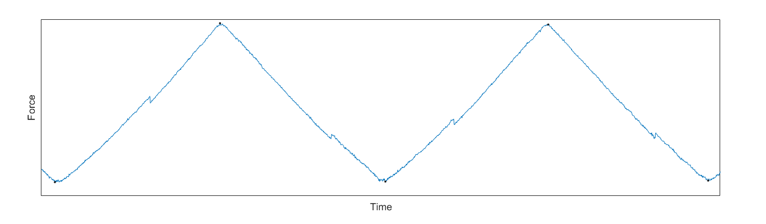
Small part of typical force time series
Rips (unfolding events) and zips (refolding events)
Challenge: Automatically detect and quantify rips and zips
Zip
Rip

Slide 5
Automatic analysis of experiment data Tasks
We have Matlab programs that can
Read and interpret an experiment file
Find individual pull and relax traces
For each trace:
Find candidate rip/zip events
Select best candidate (or reject all)
Calculate rip/zip properties
Results should be inspected manually
Remove falsely identified events
Add rips or zips missed by the program

Slide 6
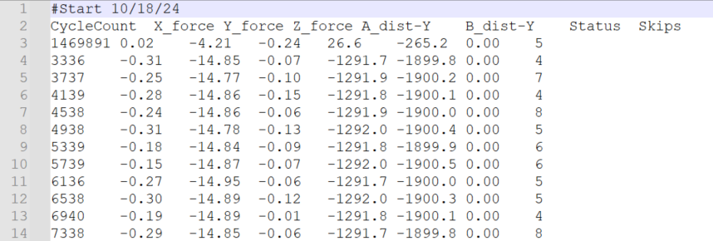
Experiment data file Steve Smith’s apparatus
Skip first record
seconds*4000
Use mean of trap positions A and B
(minus) Force (pN)
(minus) Trap pos. A
(minus) Trap pos. B
Temperature code

Slide 7
Read and interpret experiment file
Files are read by the function read_experiment_file
Record formats may vary
I use the one from Steve Smith’s apparatus
Other formats may require changes this function
Data read for each record:
Time in seconds or CycleCount: 4000 cycles/s
Force (pN)
Trap position (nm)
Temperature (coded in Status column)

Slide 8
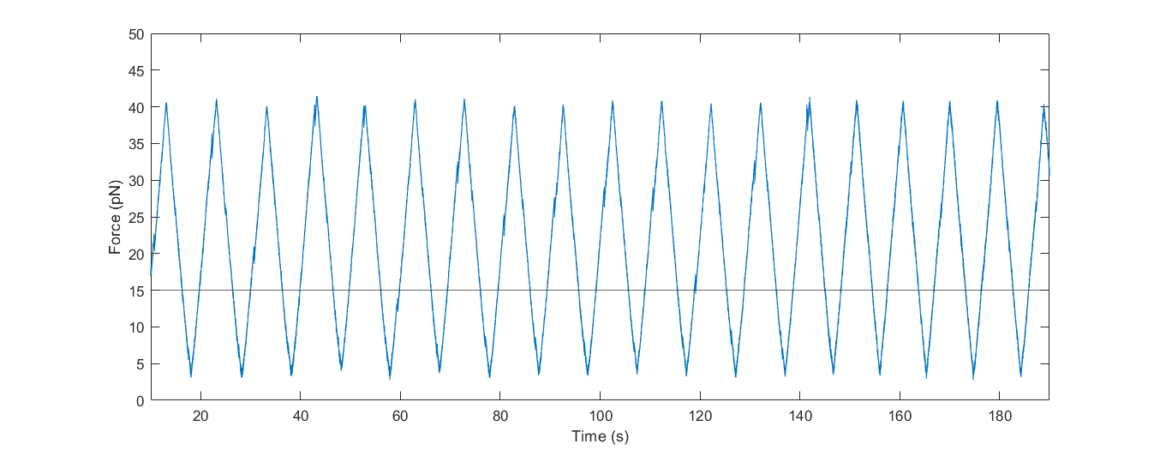
Find individual pull and relax traces
Start by finding all parts with force above and below some threshold value

Slide 9
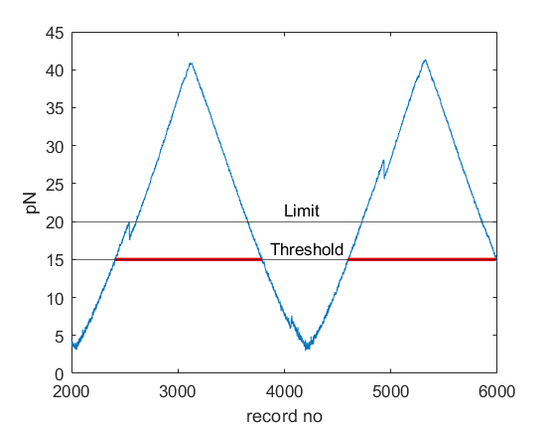
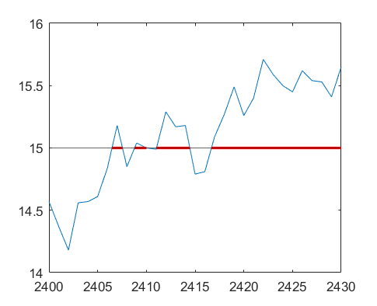
Find individual pull and relax traces
To eliminate the effect of measurement noise:
Keep only those intervals where the force exceeds a given limit (e.g. 20pN)
Values of threshold and limit have now been reduced to 12pN and 16pN
zoom
Record no.
Noise

Slide 10
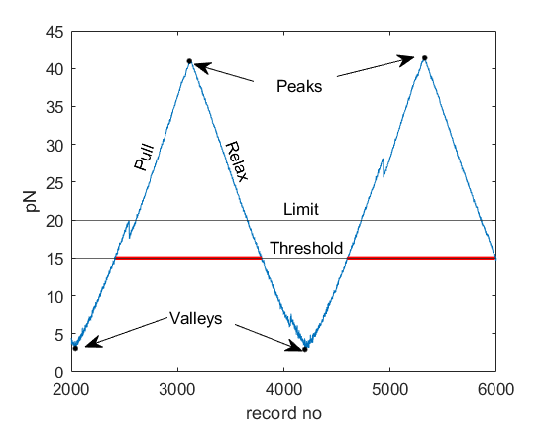
Find individual pull and relax traces (2)
Peakpos: Record no of maximum value in a high force interval
Valleypos: Record no of minimum value of f between two high force intervals
Interval from a valleypos to the next peakpos is a pull trace
Interval from a peakpos to the next valleypos is a relaxing trace

Slide 11
Find individual pull and relax traces (3)
I have just learned from Steve Smith that the pulling and relaxing traces are specified by the last digit in the COM file
(More about the COM file later)
As long as we use experiment files from any of Steve’s instruments the logic of the two previous slides is therefore not needed.
This may be taken into account in future releases

Slide 12
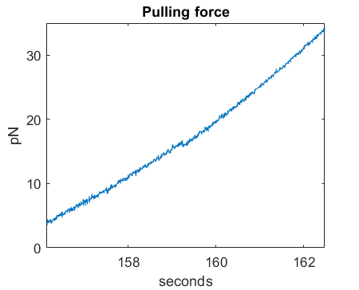
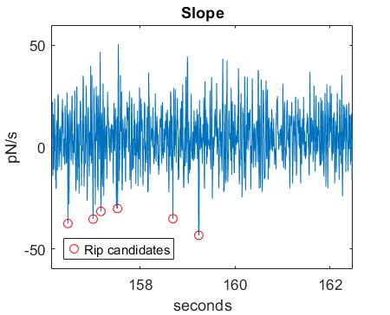
Find rip in a pull trace
Calculate local slope df/dt
A rip shows up as point of negative slope
Check the points with the most negative slope values

Slide 13
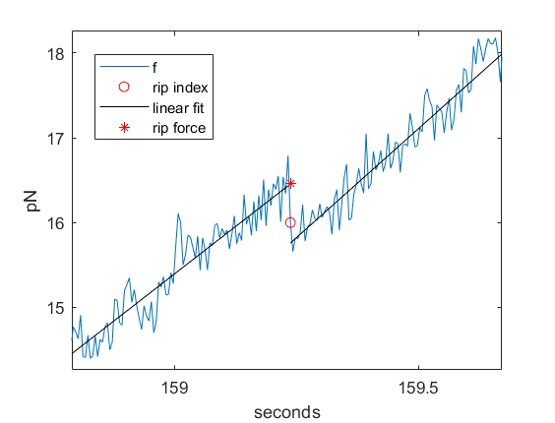
Find rip in a pull trace (2)
Fit straight lines before and after rip candidates
Force shift: distance between lines
Force shift must be larger than signal noise to be valid
Rip force is the fitted value at the rip
Select the valid candidate with the largest shift
(There are more tests and criteria, but let us not get too technical)

Slide 14
Rip distance Δx
Trap
Steve informs me that the elastic spring action results from a combination of beads and DNA handles .

Slide 15
Rip distance Δx
Δx is the difference in trap position at rip force before and after rip.
The length of the bead+DNA springs at rip force is the same before and after the rip
Thus, Δx is equal to the difference in protein “length” between the folded and unfolded shapes at the rip force

Slide 16
Rip/zip properties
Time
Force
Trap position x
Δx
Force shift
Slope before rip (df/dx)
Force rate of change before rip (df/dt)
Trap pulling speed (dx/dt)
Temperature (optional)
Note that axes are swapped

Slide 17
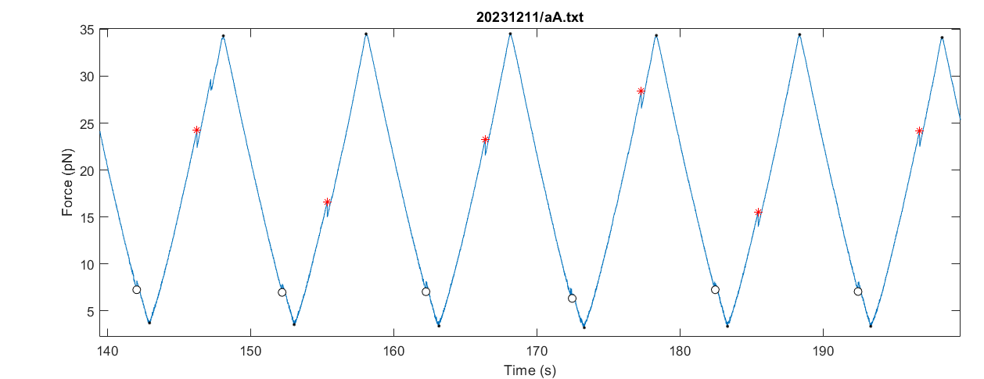
Automatic analysis of experiment data
For “well behaved” data the program works very well

Slide 18
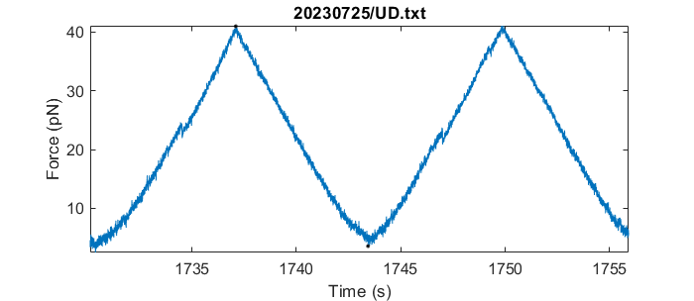
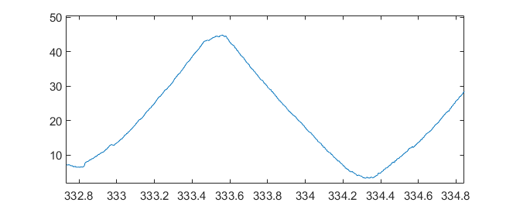
Automatic analysis of experiment data Challenges
Measurement noise
The program fails to find rips here
Weak rips
The program finds rips here

Slide 19
Pulling force and the unfolded protein
The protein is a chain (polymer) of amino acids
The DNA tethers connect to points near the ends of this chain
Δx is the increase in the distance between the tether points when the protein unfolds
The length of the unfolded polymer increases with the pulling force
Thus Δx increases with the rip force

Slide 20
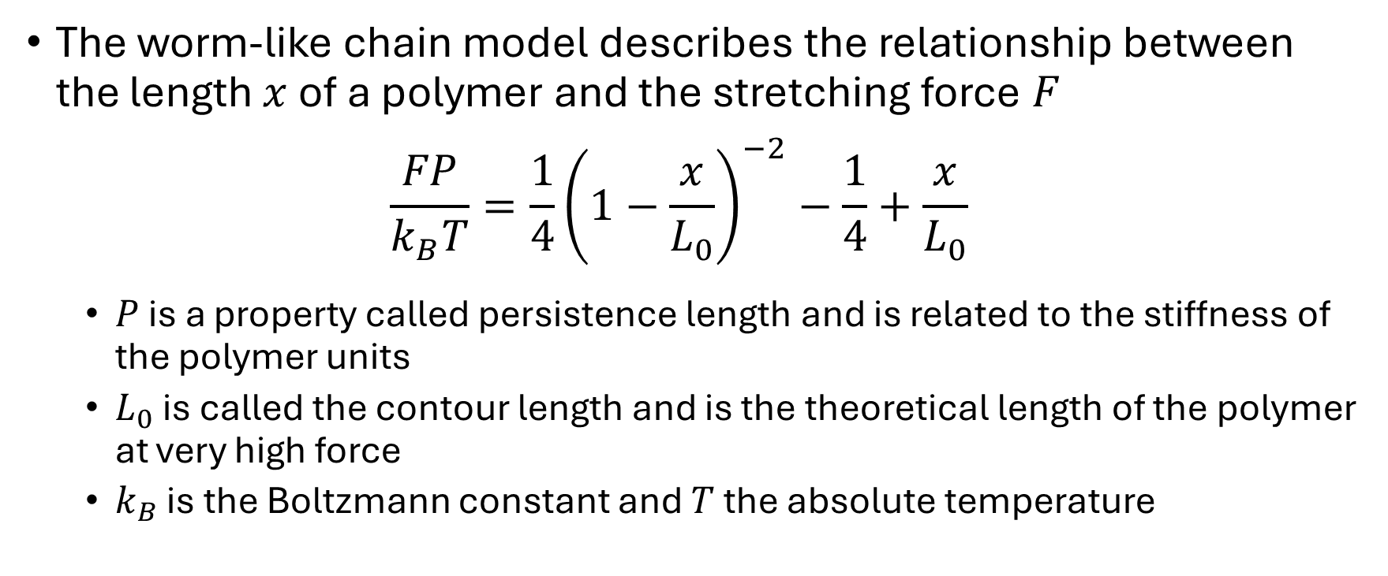
The worm-like chain model
The worm-like chain model describes the relationship between the length $x$ of a polymer and the stretching force $F$ $\frac{FP}{k_{B}T}=\frac{1}{4}{\left(1−\frac{x}{L_{0}}\right)}^{−2}−\frac{1}{4}+\frac{x}{L_{0}}$
$P$ is a property called persistence length and is related to the stiffness of the polymer units
$L_{0}$ is called the contour length and is the theoretical length of the polymer at very high force
$k_{B}$ is the Boltzmann constant and $T$ the absolute temperature

Slide 21
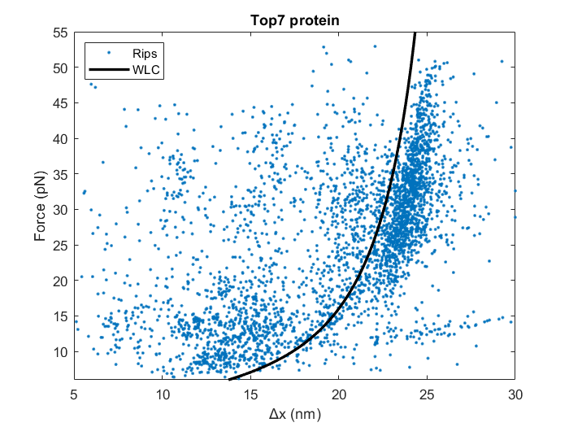
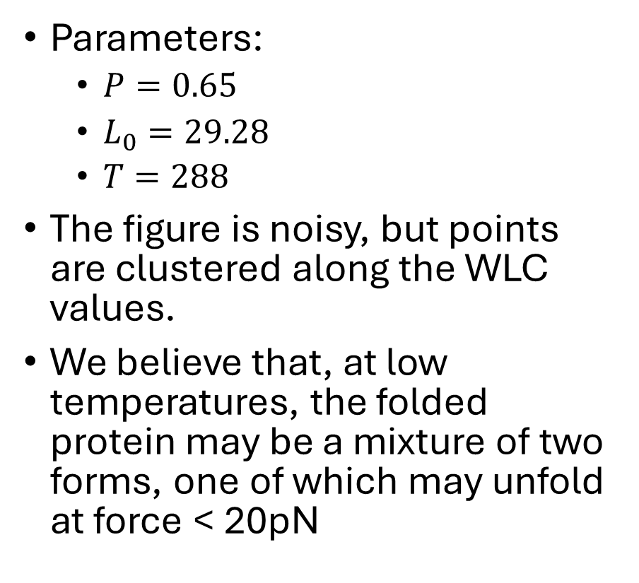
Worm-like chain Top7 protein
Parameters:
$P=0.65$
$L_{0}=29.28$
$T=288$
The figure is noisy, but points are clustered along the WLC values.
We believe that, at low temperatures, the folded protein may be a mixture of two forms, one of which may unfold at force < 20pN

Slide 22
Using Matlab to analyse experiments
The following is a quick walk-through
We will go through this more slowly in the exercises
Assuming you have already installed Matlab
Or work together with someone who has
Download Matlab files from https://github.com/are-mj/OpticalTweezers
Copy your experiment *.txt files to a folder on your computer
Or use a network folder

Slide 23
Suggested experiment file organisation
I prefer to store the experiment files in one data folder
I use one level of subfolders for storing experiment files.
Subfolders can for instance be named by experiment date.
Refer to individual file as e.g . Subfolder1/Aa.txt
Most of my functions automatically add the data folder when needed:
fullfile(datafolder,'Subfolder1/Aa.txt')

Slide 24
Workflow – single file
The file datafolder_template.m returns a sample folder path:
function folder = datafolder_template
% Template for the user's datafolder.m
folder = 'C:\Users\Are\OneDrive\Data\Chile’;
Change the folder path to your data folder and the delete ‘_template’ from the function name.
Save as datafolder.m

Slide 25
Automatic analysis of an experiment file
The Matlab function analyse_experiment performs an automatic analysis
Returns Matlab tables
Trip and Tzip
Tables contain details of all rips and zips
Enter into command window of MATLAB:
[Trip,Tzip] = analyse_experiment('subfolder1/aA.txt',1);
Plot results

Slide 26

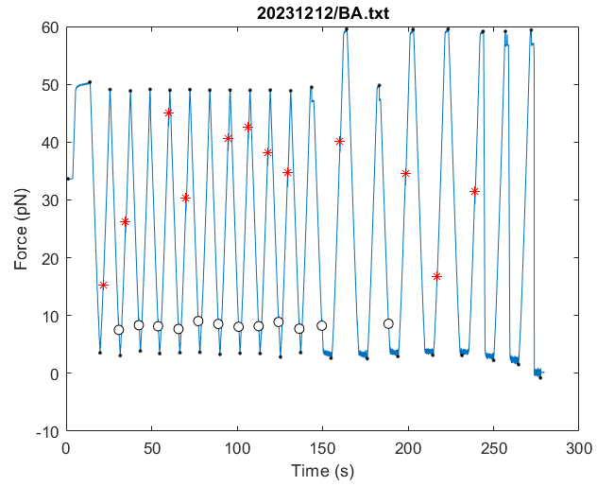

Workflow (continued)
Inspect the plot to see if rips and zips seem correct
Use the axes toolbar:
Zoom
Pan

Slide 27
Matlab results tables Trip and Tzip Contains data for all rip and zip events
Filename
Time
Deltax
Force
Temperature
Forceshift
Ripx Trap position
Fdot Force rate of change df/dt
Slope df/dx
Pullingspeed dx/dt
Noise Measurement noise
Timestep Time between records

Slide 28
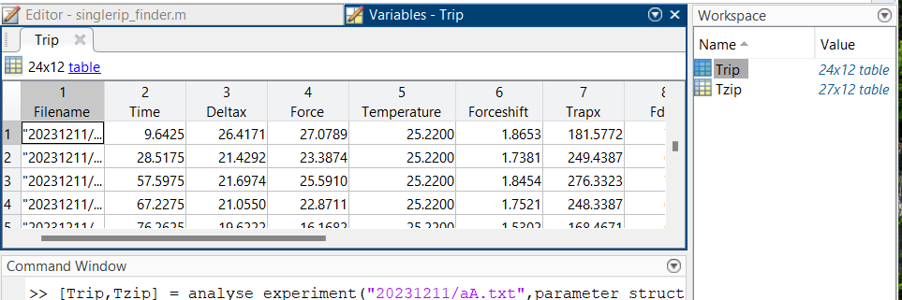
Results tables
Tables may be inspected in Matlab
or exported to Excel

Slide 29
Exporting results tables Trip and Tzip
Tables may be exported to Excel:
Create a results folder:
resultsfolder = 'C:\Users\are\myresults\';
mkdir(resultsfolder)
Create subfolder
mkdir(resultsfolder,"20231212")
Save tables save 20231212/BA.mat Trip Tzip
Create Excel file
writetable(Trip,fullfile(resultsfolder,"20231212/BA.xlsx"),"Sheet","Rips");
writetable(Tzip,fullfile(resultsfolder,"20231212/BA.xlsx"),"Sheet",“Zips");

Slide 30
The RipAnalysis Matlab App
Interactive inspection and modification of results
Removal of incorrect rips or zips
Adding missed rips/zips
Plots of f(x) for trace pairs
Removal of irrelevant data at experiment start or end
Storing corrected results tables
Experiment files are not changed
Recreate plots from stored results tables and original file

Slide 31
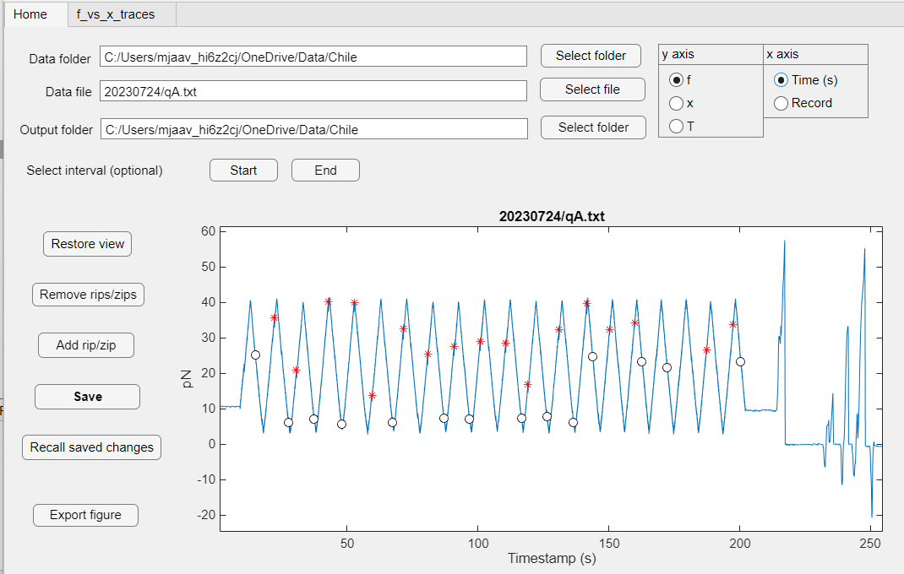

Slide 32


RipAnalysis app
Zoom and pan with the tools
Remove or add rips
Eliminate bad data at start or end
Select variables to plot
Save modified Trip and Tzip tables
Recall changes
After loading original file

Slide 33
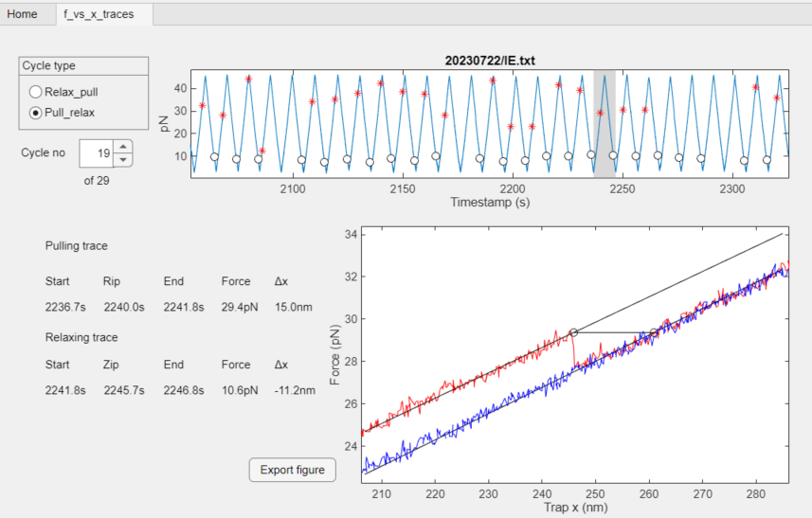
The RipAnalysis app: f(x) tab

Slide 34
Technical details: Extra heating
The bath temperature is recorded in the COM file, e.g. aCOM.txt
A separate heating element may increase the chamber temperature above the bath temperature. The setting for this element is recorded in digits 2 and 3 in the status column in the experiment file.
The mapping from setting to temperature increase is given by the table Tlist in params.m.
NOTE: Relevant for Steve’s instrument. Other instruments may handle temperature differently.

Slide 35

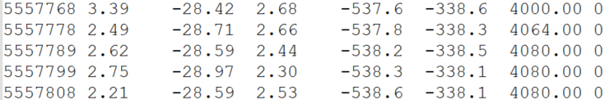
Temperature from COM file and status column
In Com file:
Tbath = TemperatureB
In Status column
Code = cols 2-3
Tlist T = 5.63 + 13.75 = 19.38˚C
Code | 00 | 02 | 04 | 06 | 08 | 10 | 14 | 12 | 16 | 20 | 24 | 31
ΔT | 0 | 3.07 | 6.96 | 10.78 | 13.75 | 16.92 | 20.14 | 22.92 | 25.1 | 28.01 | 30.77 | 34.83

Slide 36
Technical details: Naming conventions
Experiment file naming conventions
Fiber (individual protein molecule) named by one or two lowercase letters
Data from a long experiment may be split over several files. Marked by uppercase letters
Bath Temperature
Bath temperature is reported in the COM file as Temperature B.
COM file name is given by the fiber name
aA.txt aB.txt: Data from long experiment using fiber a. COM file: aCOM.txt
abA.txt: Experiment using fiber ab. COM file: abCOM.txt

Slide 37
Combining several files for the same fiber
Results for long experiments on the same fiber are often distributed among several files
E.g. aA.txt, aB.txt, aC.txt, aD.txt, …
Function analyse_fiber(fiber) lets you analyse all files together.
You specify only the subfolder and fiber part
[Trip,Tzip] = analyse_fiber("subfolder1/a");
The files are analysed in alphabetical sequence
Note that the RipAnalysis app and the collect_tables function can so far only handle individual files

Slide 38
Parameter file params.m
function par = params
par.threshold = 12; par.lim = 16;
par.minfitfraction = 0.05; par.maxfitfraction = 0.15;
par.supportlength = 5;
par.ripsteps = 1;
par.overstretch = 55;
par.noisefactor = [3,1];
par.min_fstep = 0.4;
par.maxzipfactor = 0.65;
par.Tlist
Default parameter file read by analyse_experiment
See slide: Find individual pull and relax traces
Fraction of trace length used for fitting straight lines around rip/zip Skip rips that are too close to end of trace
Number of data point used to find local slope
Number of records between steepest force change and rip position
Maximum rip force
Determines the minimum force step relative to the noise
Minimum force step for valid rip, regardless of noise
Disregard zips at force > maxzipfactor*max(force)
See slide Temperature from COM file and status column

Slide 39
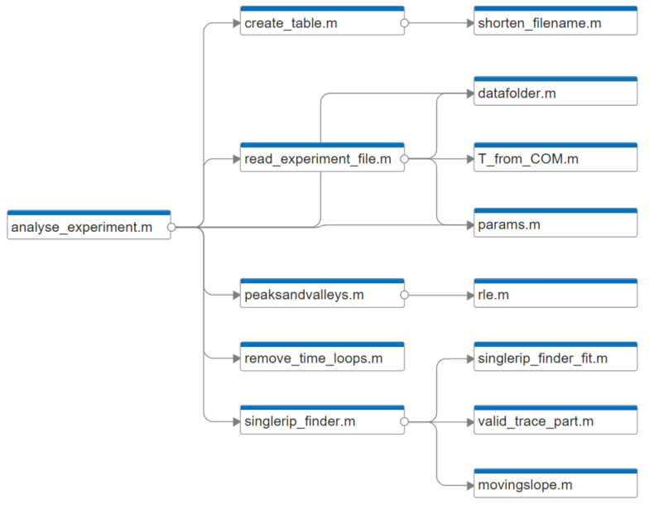
Matlab program structure

